Slide 1
Chapter 6: Asymmetric Information
Ch 37 in H. Varian 8th Ed.
Slides by Mariona Segú, CYU Cergy Paris Université
Inspired by Michael D. Robinson, Mount Holyoke College

Slide 2
Information in Competitive Markets
So far…
We have assumed that all agents are fully informed about traded commodities and other aspects of the market.
But... This might not be true in some cases:
Quality is hard to tell. Ex: labor market
What about markets for medical services, or insurance, or used cars?

Slide 3
Asymmetric Information in Markets
Examples:
A doctor knows more about medical services than does the buyer.
An insurance buyer knows more about his riskiness than does the seller.
A used car’s owner knows more about it than does a potential buyer.

Slide 4
Asymmetric Information in Markets
Markets with one side or the other imperfectly informed are markets with imperfect information.
Imperfectly informed markets with one side better informed than the other are markets with asymmetric information.
In what ways can asymmetric information affect the functioning of a market?
Two applications will be considered:
Adverse Selection
Solved with signaling
Moral Hazard
Solved with incentives contracting.

Slide 5
Outline
The Lemons market
Adverse selection with quality choice
Signaling
Moral Hazard
Incentives contracting

Slide 6
1. The Lemons market
Consider a used car market.
Two types of cars; “lemons” and “peaches”.
Each lemon seller will accept $1,000, a buyer will pay at most $1,200.
Each peach seller will accept $2,000, a buyer will pay at most $2,400.

Slide 7
The Lemons market
Perfect information
If every buyer can tell a peach from a lemon, then lemons sell for between $1,000 and $1,200, and peaches sell for between $2,000 and $2,400.
Gains-to-trade are generated when buyers are well informed.

Slide 8
The Lemons market
Asymmetric information
Suppose no buyer can tell a peach from a lemon before buying.
What is the most a buyer will pay for any car?

Slide 9
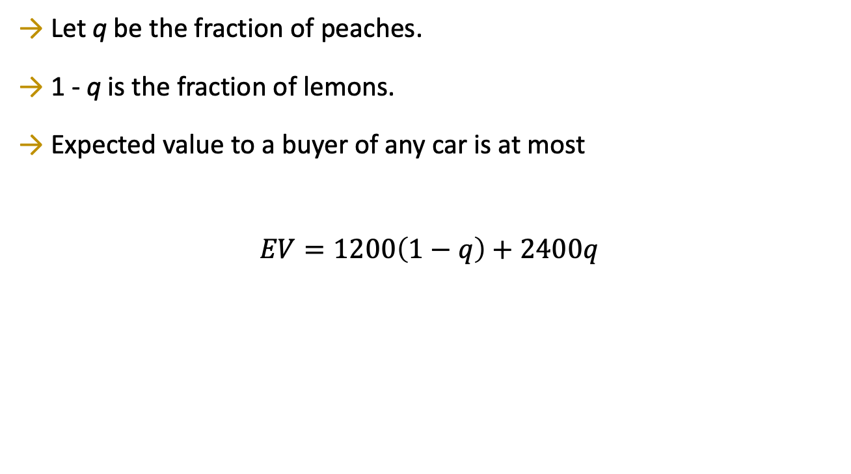
The Lemons market

Slide 10
The Lemons market
Suppose EV > $2000.
Every seller can negotiate a price between $2000 and $EV (no matter if the car is a lemon or a peach).
All sellers gain from being in the market.

Slide 11
The Lemons market
Suppose EV < $2000.
A peach seller cannot negotiate a price above $2000 and will exit the market.
So all buyers know that remaining sellers own lemons only.
Buyers will pay at most $1200 and only lemons are sold.

Slide 12
The Lemons market
Hence “too many” lemons “crowd out” the peaches from the market.
Gains-to-trade are reduced since no peaches are traded.
The presence of the lemons inflicts an external cost on buyers and peach owners.
Market failure: there is an externality
when an individual decides to try to sell a bad car, he affects the purchasers’ perceptions of the quality of the average car on the market

Slide 13
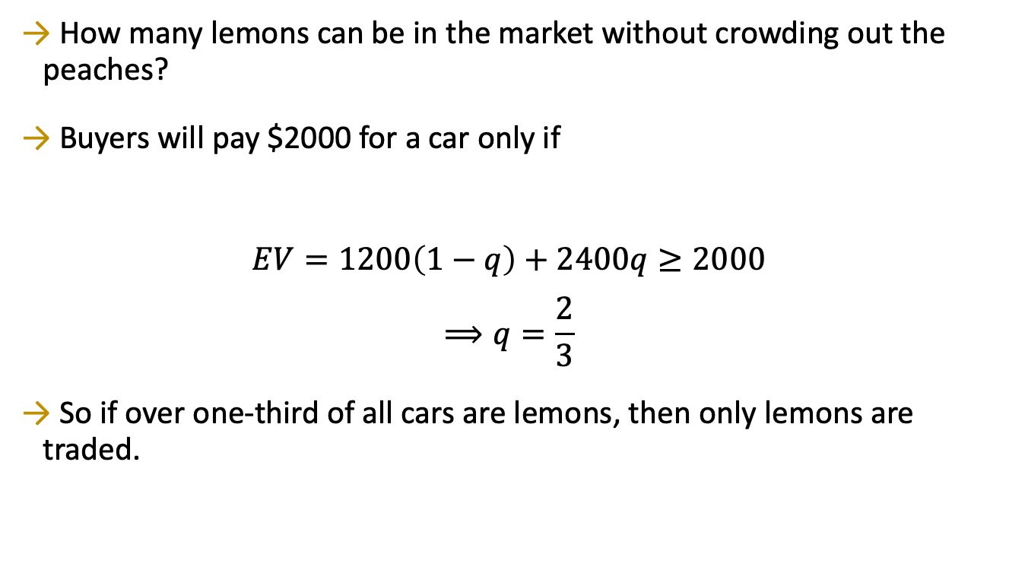
The Lemons market

Slide 14
The Lemons market - Equilibrium
Pooling equilibrium: A market equilibrium in which both types of cars are traded, and buyers cannot distinguish the type of car.
Separating equilibrium: A market equilibrium in which only one of the two types of cars is traded, or both are traded but can be distinguished by the buyers.

Slide 15
The Lemons market – continuous quality
What if there is more than two types of cars?
Suppose that
car quality is Uniformly distributed between $1000 and $2000
any car that a seller values at $x is valued by a buyer at $(x+300).
Which cars will be traded?

Slide 16
The Lemons market – continuous quality
1000
2000
Seller values

Slide 17
The Lemons market – continuous quality
Mid point
1000
1500
2000
Seller values

Slide 18
The Lemons market – continuous quality
The expected value of any
car to a buyer is
$1500 + $300 = $1800.
1000
1500
2000
Seller values

Slide 19
The Lemons market – continuous quality
The expected value of any
car to a buyer is
$1500 + $300 = $1800.
1000
1500
2000
Seller values
So sellers who value their cars at
more than $1800 exit the market.

Slide 20
The Lemons market – continuous quality
The distribution of values
of cars remaining on offer
1000
1800
Seller values

Slide 21
The Lemons market – continuous quality
1000
1400
1800
Seller values

Slide 22
The Lemons market – continuous quality
The expected value of any
remaining car to a buyer is
$1400 + $300 = $1700.
1000
1400
1800
Seller values

Slide 23
The Lemons market – continuous quality
The expected value of any
remaining car to a buyer is
$1400 + $300 = $1700.
1000
1400
1800
Seller values
So now sellers who value their cars
between $1700 and $1800 exit the market.

Slide 24
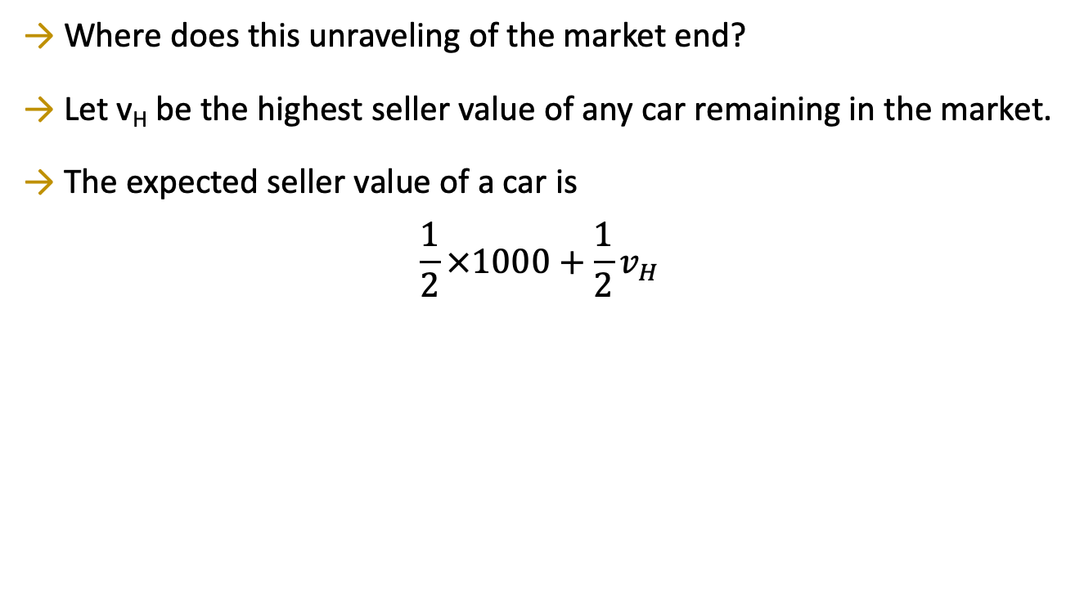
The Lemons market – continuous quality

Slide 25
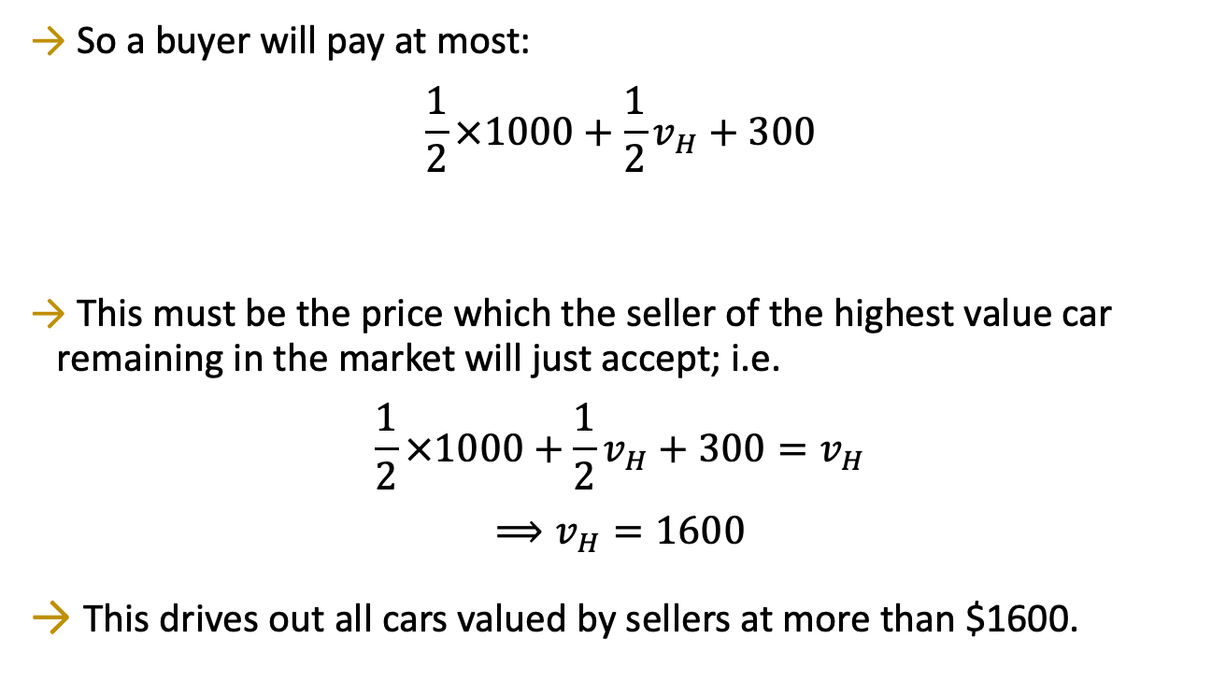
The Lemons market – continuous quality

Slide 26
The Lemons market – continuous quality
This is an example of ADVERSE SELECTION
There is an adverse selection of one type of cars (low-quality ones)
Adverse selection refers to situations where one side of the market can’t observe the “type” or quality of the goods on other side of the market.
Adverse selection is the hidden type problem
The term adverse selection was first used in the insurance industry to describe the fact that only more risky clients would contract an insurance
Solution: compulsory insurance

Slide 27
2. Adverse Selection with Quality Choice
Now assume that each seller can choose the quality, or value, of her product.
EXAMPLE
Two umbrellas: high-quality and low-quality.
Which will be manufactured and sold?

Slide 28
Adverse Selection with Quality Choice
Buyers value a high-quality umbrella at $14 and a low-quality umbrella at $8.
Before buying, no buyer can tell quality.
Marginal production cost of a high-quality umbrella is $11.
Marginal production cost of a low-quality umbrella is $10.

Slide 29
Adverse Selection with Quality Choice
Suppose every seller makes only high-quality umbrellas.
Every buyer pays $14 and sellers’ profit per umbrella is $14 - $11 = $3.
But then a seller can make low-quality umbrellas for which buyers still pay $14, so increasing profit to $14 - $10 = $4.

Slide 30
Adverse Selection with Quality Choice
There is no market equilibrium in which only high-quality umbrellas are traded.
Is there a market equilibrium in which only low-quality umbrellas are traded?

Slide 31
Adverse Selection with Quality Choice
All sellers make only low-quality umbrellas.
Buyers pay at most $8 for an umbrella, while marginal production cost is $10.
There is no market equilibrium in which only low-quality umbrellas are traded.

Slide 32
Adverse Selection with Quality Choice
Now we know there is no market equilibrium in which only one type of umbrella is manufactured.
Is there an equilibrium in which both types of umbrella are manufactured?

Slide 33
Adverse Selection with Quality Choice
A fraction q of sellers make high-quality umbrellas; 0 < q < 1.
Buyers’ expected value of an umbrella is EV = 14q + 8(1 - q) = 8 + 6q.
High-quality manufacturers must recover the manufacturing cost, EV = 8 + 6q ≥ 11 ⇒ q ≥ ½

Slide 34
Adverse Selection with Quality Choice
So at least half of the sellers must make high-quality umbrellas for there to be a pooling market equilibrium.
But then a high-quality seller can switch to making low-quality and increase profit by $1 on each umbrella sold.
Since all sellers reason this way, the fraction of high-quality sellers will shrink towards zero
But then buyers will pay only $8.
So, there is no equilibrium in which both umbrella types are traded.

Slide 35
Adverse Selection with Quality Choice
To sum up
The market has no equilibrium
with just one umbrella type traded (separating eq.)
with both umbrella types traded (pooling eq.)
So the market has no equilibrium at all!
Adverse selection has destroyed the entire market!
Low-quality items crowded out the high-quality items because of the high cost of acquiring information

Slide 36
3. Signaling
Adverse selection is an outcome of an informational deficiency.
What if information can be improved by high-quality sellers signaling credibly that they are high-quality?
E.g. warranties, professional credentials, references from previous clients etc.

Slide 37
Signaling
A labor market has two types of workers: high-ability and low-ability.
A high-ability worker’s marginal product is a_{H}.
A low-ability worker’s marginal product is a_{L}.
a_{L} < a_{H}.

Slide 38
Signaling
A fraction h of all workers are high-ability.
1 - h is the fraction of low-ability workers.
Each worker is paid his expected marginal product.
If firms knew each worker’s type they would
pay each high-ability worker w_{H} = a_{H}
pay each low-ability worker w_{L} = a_{L}.

Slide 39
Signaling
If firms cannot tell workers’ types then every worker is paid the (pooling) wage rate; i.e. the expected marginal product w_{P} = (1 - h)a_{L} + ha_{H}.
w_{P} = (1 - h)a_{L} + ha_{H} < a_{H},
The pooling wage is lower than the wage paid to high-ability workers if the firm can know the type
So high-ability workers have an incentive to find a credible signal.

Slide 40
Signaling
Workers can acquire “education”.
Education costs a high-ability worker c_{H} per unit
and costs a low-ability worker c_{L} per unit.
c_{L} > c_{H}.

Slide 41
Signaling
Suppose that education has no effect on workers’ productivities; i.e., the cost of education is a deadweight loss.
High-ability workers will acquire e_{H} education units if
w_{H} - w_{L} = a_{H} - a_{L} > c_{H}e_{H}, and
w_{H} - w_{L} = a_{H} - a_{L} < c_{L}e_{H}.
Acquiring e_{H} units of education benefits high-ability workers since increase in salary is higher than cost
Acquiring e_{H} education units hurts low-ability workers since for them it is more costly to acquire the same education.

Slide 42
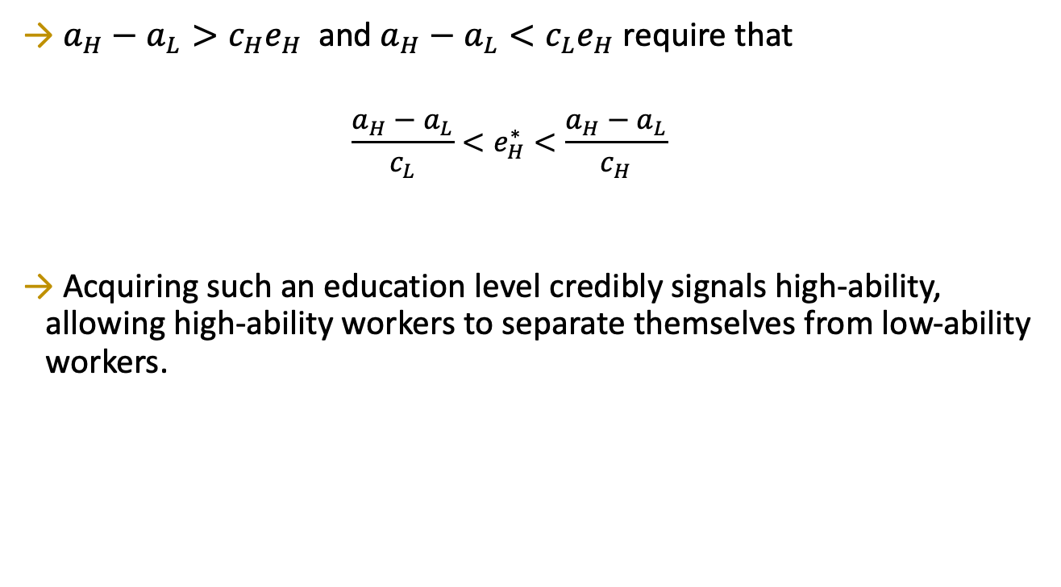
Signaling

Slide 43
Signaling
Is this an equilibrium?
For firms: YES. They are paying each worker his or her marginal product, so the firms have no incentive to deviate
But…
Q: Given that high-ability workers acquire e_{H} units of education, how much education should low-ability workers acquire?
A: Zero. Low-ability workers will be paid w_{L} = a_{L} so long as they do not have e_{H} units of education and they are still worse off if they do.
So, YES. This is an equilibrium → a separating equilibrium

Slide 44
Signaling
Signaling can improve information in the market.
But total output did not change, and education was costly so signaling worsened the market’s efficiency.
Since we assumed that education does not increase productivity, which is a strong assumption
So improved information need not improve gains-to-trade.
This is not always true!
For the used cars market, acquiring a signal (a warranty) can increase efficiency by allowing a separating equilibrium

Slide 45
4. Moral Hazard
With adverse selection, moral hazard is another problem in the insurance industry.
If you have full car insurance, are you more likely to leave your car unlocked?
Moral hazard is the lack of incentives to take care of something or of yourself.
Trade-off:
Too little insurance means that people bear a lot of risk,
Too much insurance means that people will take inadequate care.
Moral hazard is a consequence of asymmetric information.
The issue is that care is not observable.

Slide 46
Moral Hazard
If an insurer knows the exact risk from ensuring an individual, then a contract specific to that person can be written.
If all people look alike to the insurer, then one contract will be offered to all insurees. High-risk and low-risk types are then pooled, causing low-risks to subsidize high-risks.

Slide 47
Moral Hazard
Examples of efforts to avoid moral hazard by using signals are:
Higher life and medical insurance premiums for smokers or heavy drinkers of alcohol
Lower car insurance premiums for drivers with histories of safe driving.
Moral hazard is the hidden action problem

Slide 48
5. Incentives Contracting
How can I get someone to do something for me?
With the appropriate incentive system
This question will involve asymmetric information…

Slide 49
Incentives Contracting
EXAMPLE
A worker is hired by a principal to do a task.
Only the worker knows the effort she exerts (asymmetric information).
The effort exerted affects the principal’s payoff.
The principal’s problem: design an incentives contract that induces the worker to exert the amount of effort that maximizes the principal’s payoff.

Slide 50
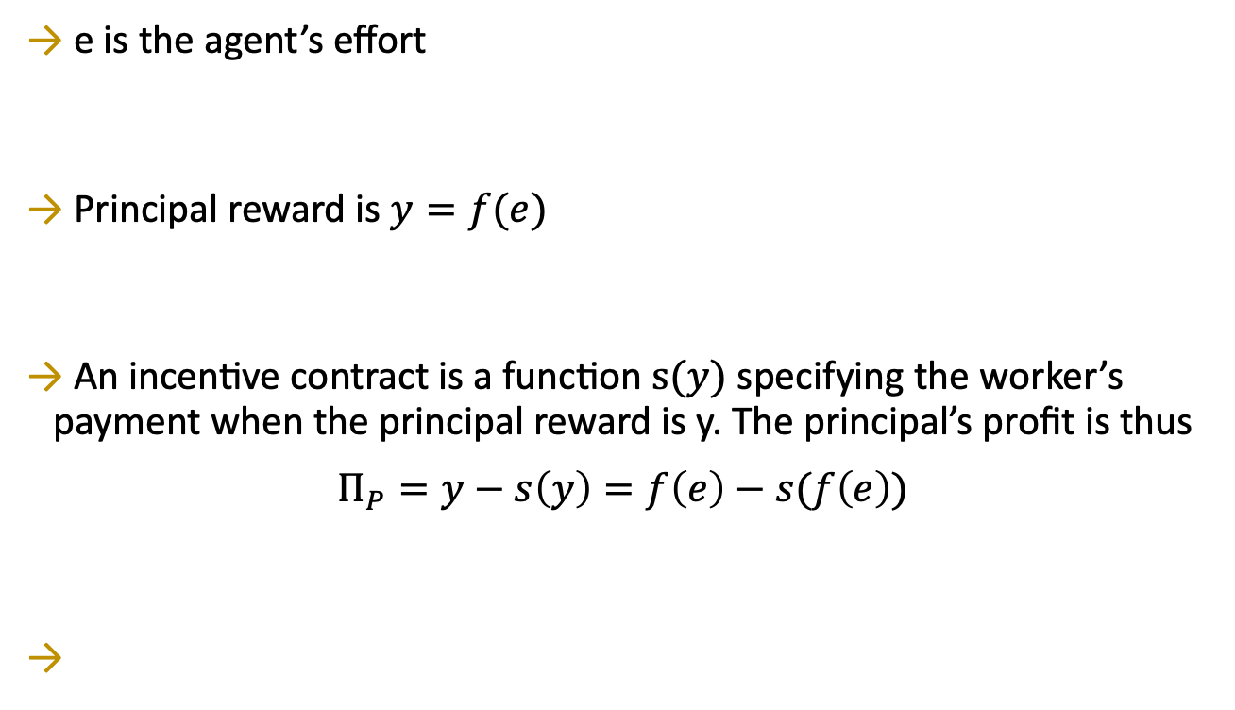
Incentives Contracting
e is the agent’s effort
Principal reward is $y=f(e)$
An incentive contract is a function $s(y)$ specifying the worker’s payment when the principal reward is y. The principal’s profit is thus
$$Π_{P}=y−s\left(y\right)=f\left(e\right)−s(f\left(e\right))$$

Slide 51

Incentives Contracting
Let $\tilde{u}$ be the worker’s (reservation) utility of not working.
To get the worker’s participation, the contract must offer the worker a utility of at least $\tilde{u}$
The worker’s utility cost of an effort level e is $c(e)$

Slide 52
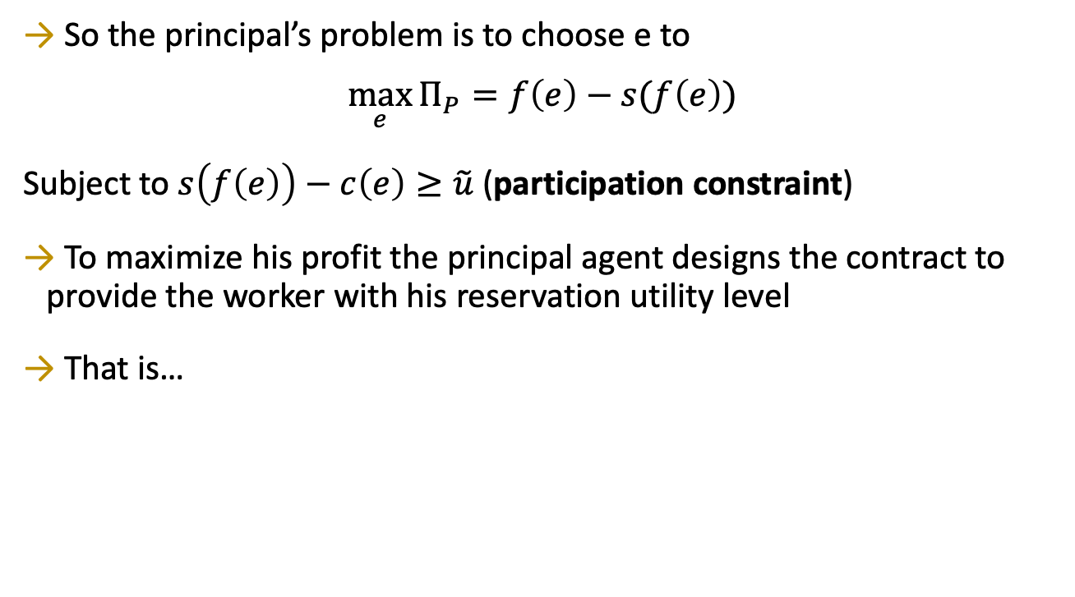
Incentives Contracting
So the principal’s problem is to choose e to
$${\max_{e}{Π}}_{P}=f\left(e\right)−s(f\left(e\right))$$
Subject to $s\left(f\left(e\right)\right)−c\left(e\right)≥\tilde{u}$ (participation constraint)
To maximize his profit the principal agent designs the contract to provide the worker with his reservation utility level
That is…

Slide 53
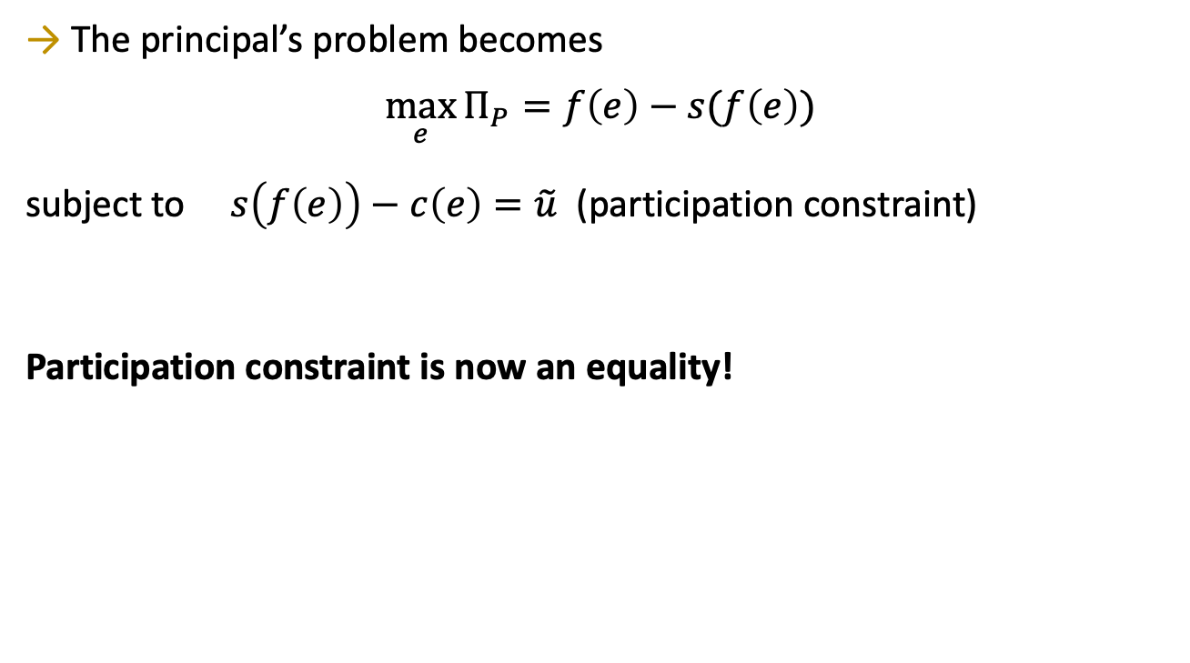
Incentives Contracting

Slide 54
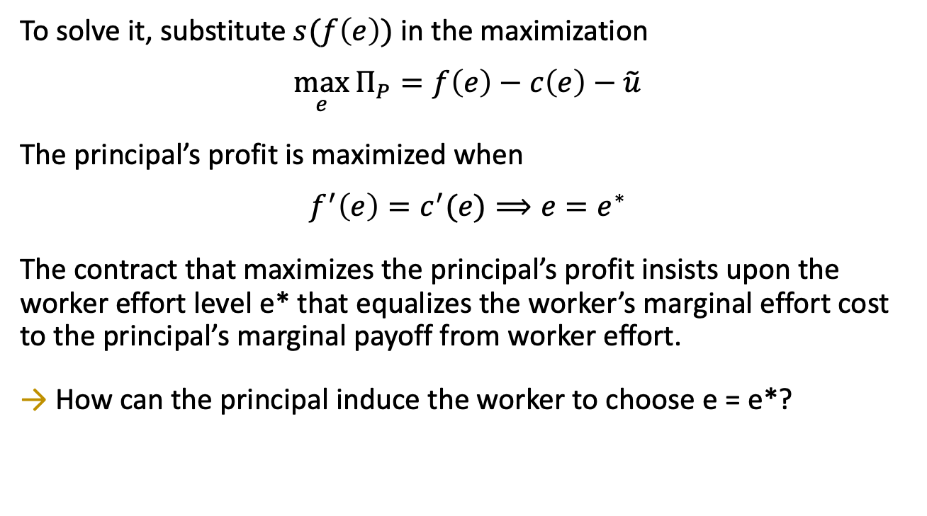
Incentives Contracting

Slide 55
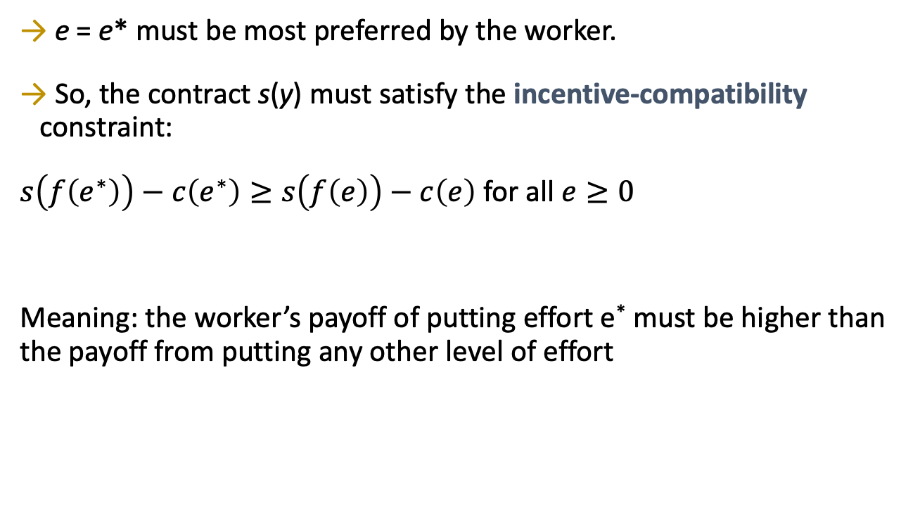
Incentives Contracting

Slide 56
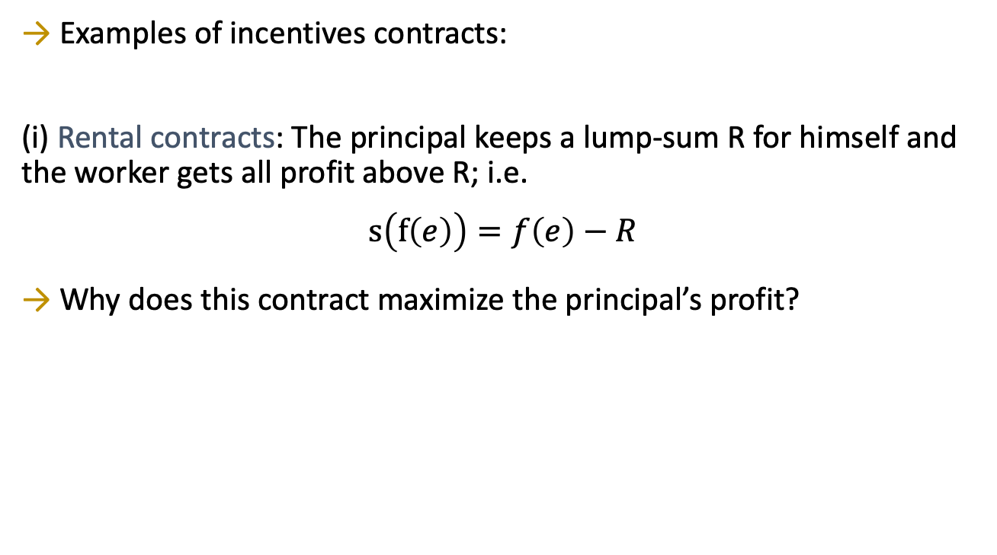
Rental Contracting
Examples of incentives contracts:
(i) Rental contracts: The principal keeps a lump-sum R for himself and the worker gets all profit above R; i.e.
$$s\left(f\left(e\right)\right)=f\left(e\right)−R$$
Why does this contract maximize the principal’s profit?

Slide 57
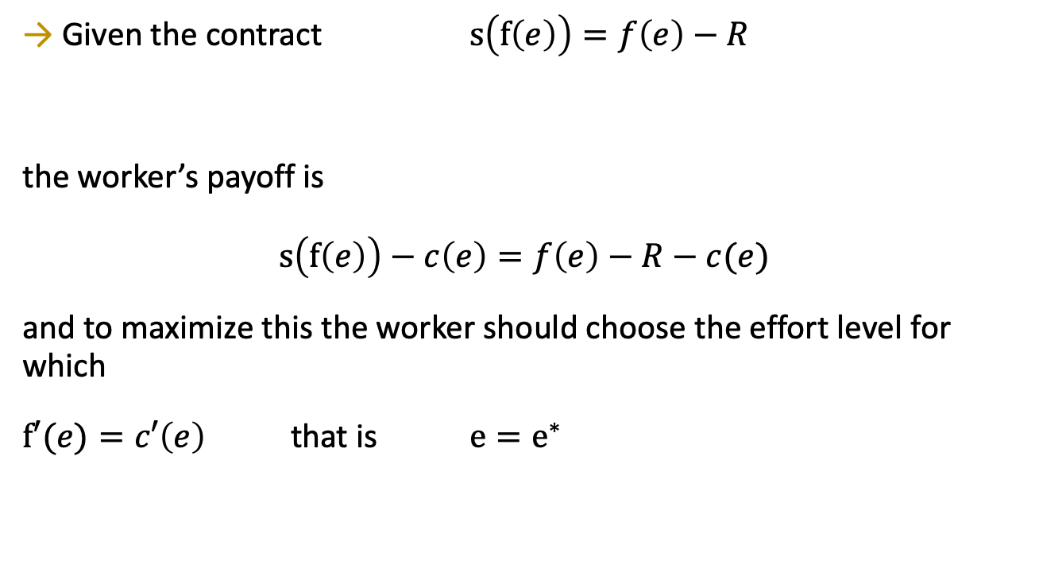
Rental Contracting
Given the contract $s\left(f\left(e\right)\right)=f\left(e\right)−R$
the worker’s payoff is $$s\left(f\left(e\right)\right)−c\left(e\right)=f\left(e\right)−R−c(e)$$
and to maximize this the worker should choose the effort level for which
$f′(e)=c′\left(e\right)$ that is $e=e^{∗}$

Slide 58
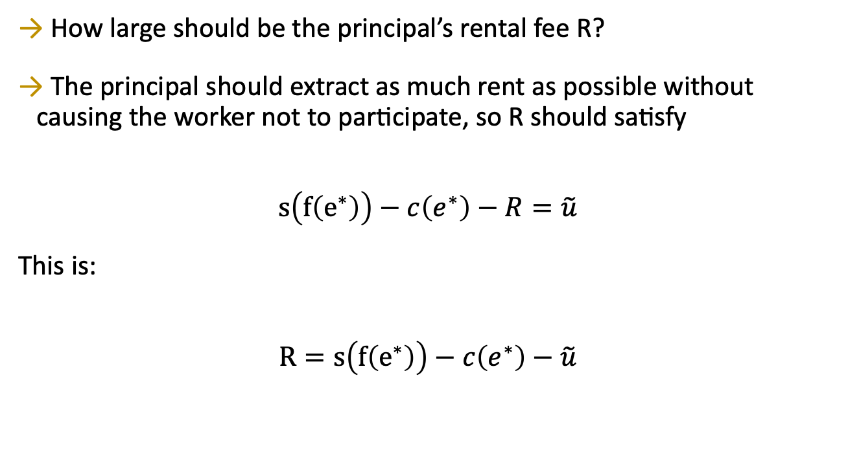
Rental Contracting
How large should be the principal’s rental fee R?
The principal should extract as much rent as possible without causing the worker not to participate, so R should satisfy
$$s\left(f\left(e^{∗}\right)\right)−c\left(e^{∗}\right)−R=\tilde{u}$$
This is:
$$R=s\left(f\left(e^{∗}\right)\right)−c\left(e^{∗}\right)−\tilde{u}$$

Slide 59
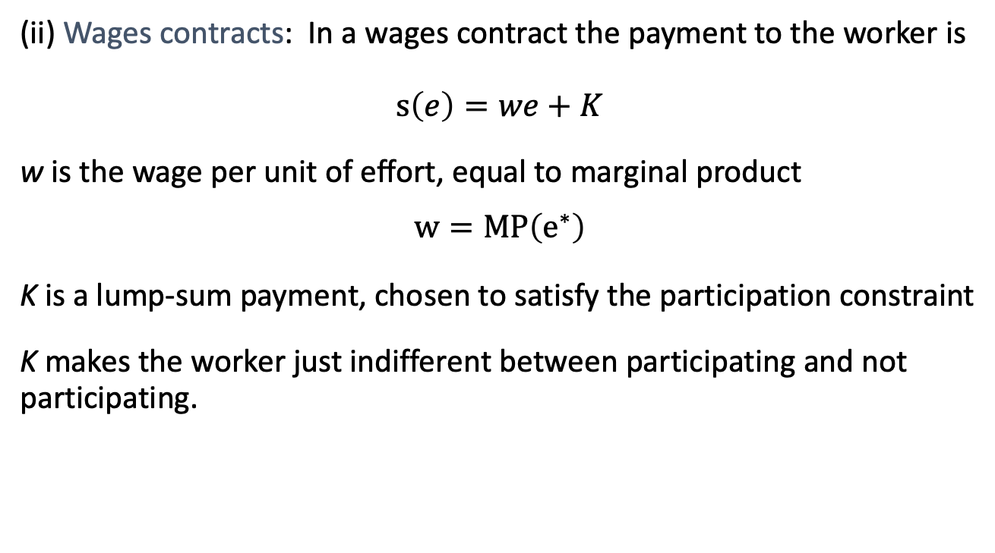
Other Incentives Contracts
(ii) Wages contracts: In a wages contract the payment to the worker is $$s\left(e\right)=we+K$$
w is the wage per unit of effort, equal to marginal product
$$w=MP\left(e^{∗}\right)$$
K is a lump-sum payment, chosen to satisfy the participation constraint
K makes the worker just indifferent between participating and not participating.

Slide 60
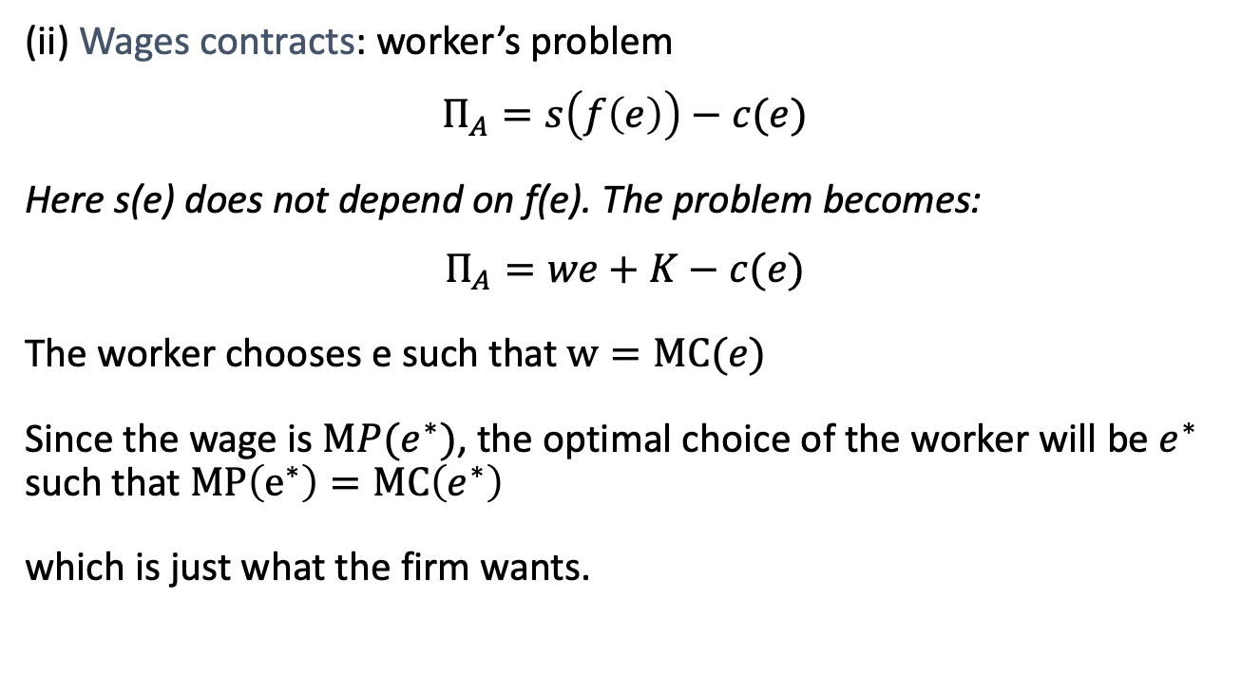
Other Incentives Contracts
(ii) Wages contracts: worker’s problem
$$Π_{A}=s\left(f\left(e\right)\right)−c(e)$$
Here s(e) does not depend on f(e). The problem becomes:
$$Π_{A}=we+K−c(e)$$
The worker chooses e such that $w=MC(e)$
Since the wage is $MP(e^{∗})$, the optimal choice of the worker will be $e^{∗}$ such that $MP\left(e^{∗}\right)=MC\left(e^{∗}\right)$
which is just what the firm wants.

Slide 61
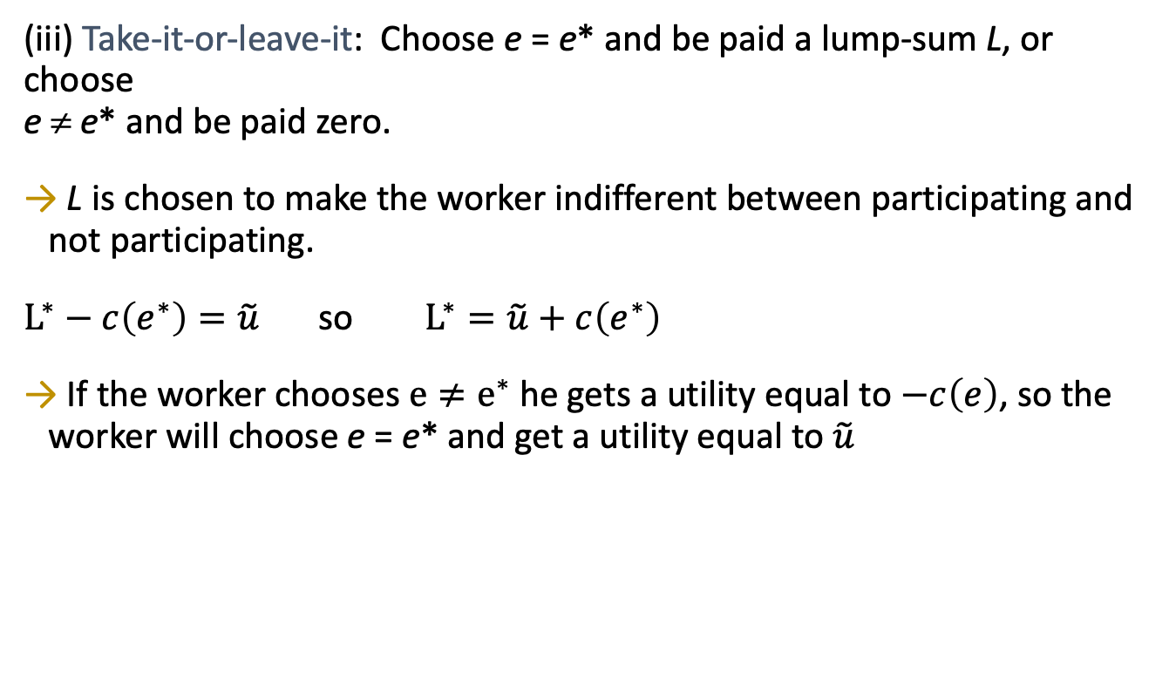
Other Incentives Contracts
(iii) Take-it-or-leave-it: Choose e = e* and be paid a lump-sum L, or choose e ≠ e* and be paid zero.
L is chosen to make the worker indifferent between participating and not participating.
$L^{∗}−c\left(e^{∗}\right)=\tilde{u}$ so $L^{∗}=\tilde{u}+c\left(e^{∗}\right)$
If the worker chooses $e≠e^{∗}$ he gets a utility equal to $−c\left(e\right)$, so the worker will choose e = e* and get a utility equal to $\tilde{u}$

Slide 62
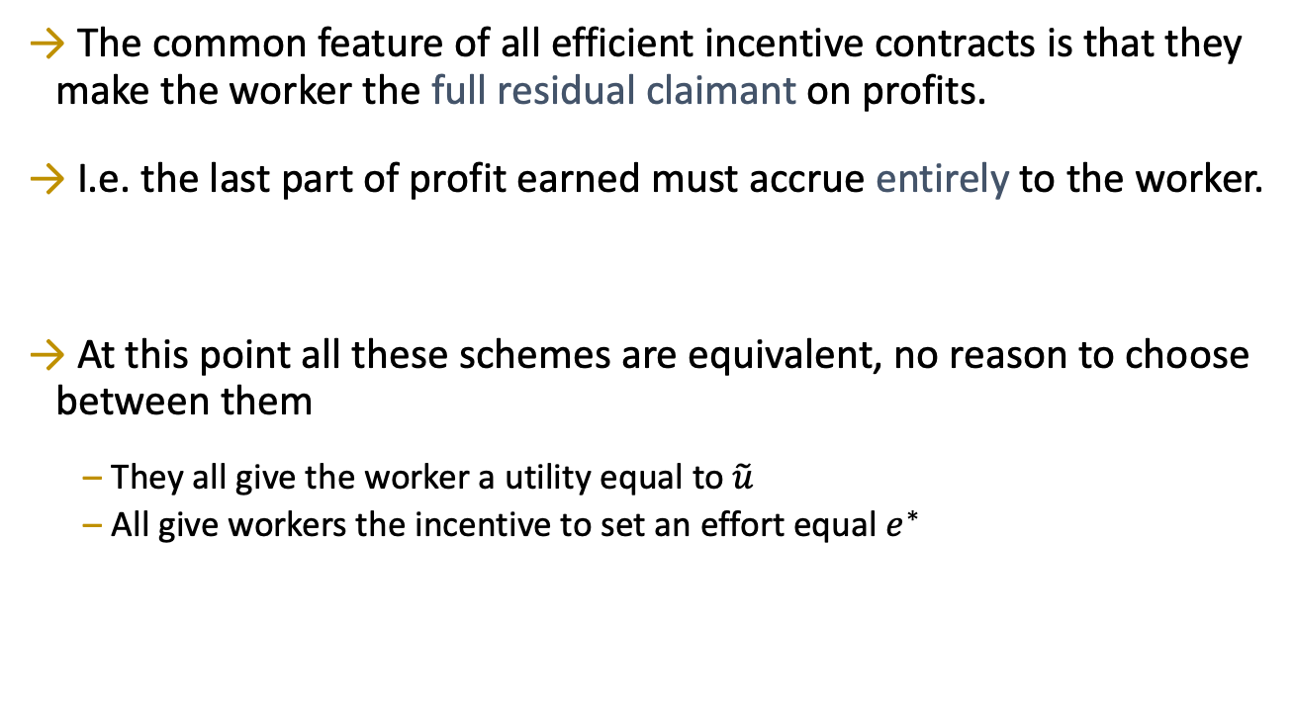
Incentives Contracts in General
The common feature of all efficient incentive contracts is that they make the worker the full residual claimant on profits.
I.e. the last part of profit earned must accrue entirely to the worker.
At this point all these schemes are equivalent, no reason to choose between them
They all give the worker a utility equal to $\tilde{u}$
All give workers the incentive to set an effort equal $e^{∗}$

